Slide 1


Azure Workshop
Azure storage
NOVEMBER 17, 2018

Slide 2

Agenda
Available options
Azure Storage:
Azure Blob storage
Azure Table storage
Azure SQL Database
Azure Cosmos DB

Slide 3
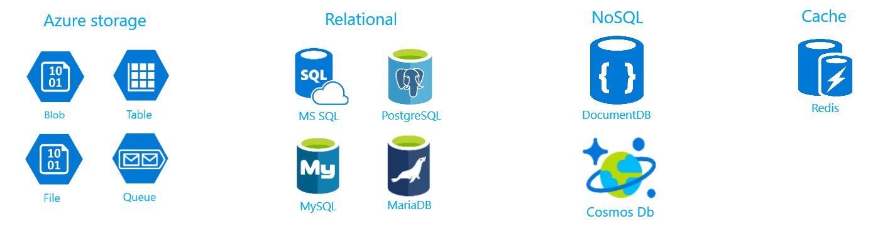
Available options

Slide 4
Azure Storage

Slide 5
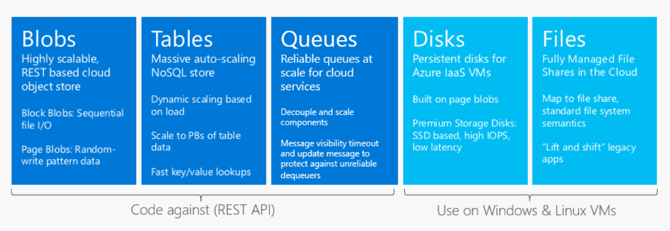
Azure Storage

Slide 6

Azure Blob storage
Blob Storage stores unstructured object data and can be any type of text or binary data
Optimized for storing and accessing binary files
Two types of blobs: page and block
Access via REST API
Blob storage documentation
Comparison of blobs, files and disks

Slide 7
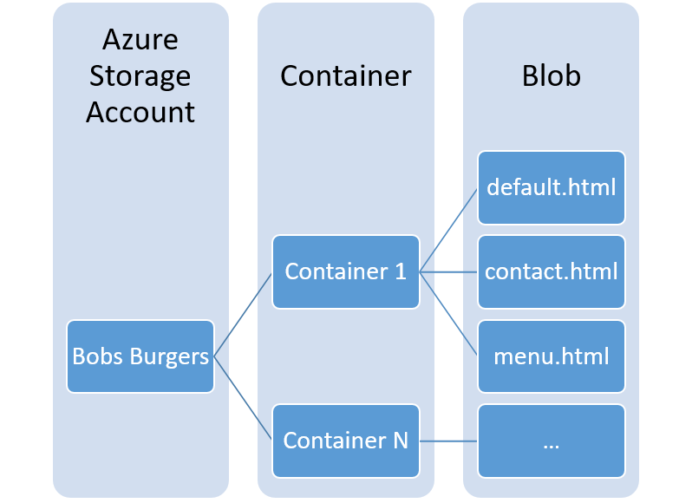
How is it stored?

Slide 8

Azure Table storage
NoSQL key-value data store
Optimized for key-base lookups
Consistent
Cost efficient
Azure Table storage documentation

Slide 9
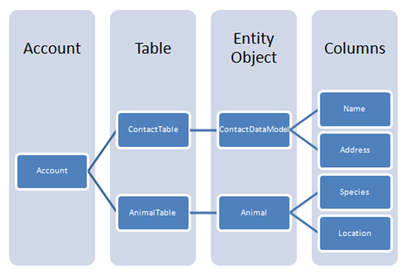
How is it stored?

Slide 10
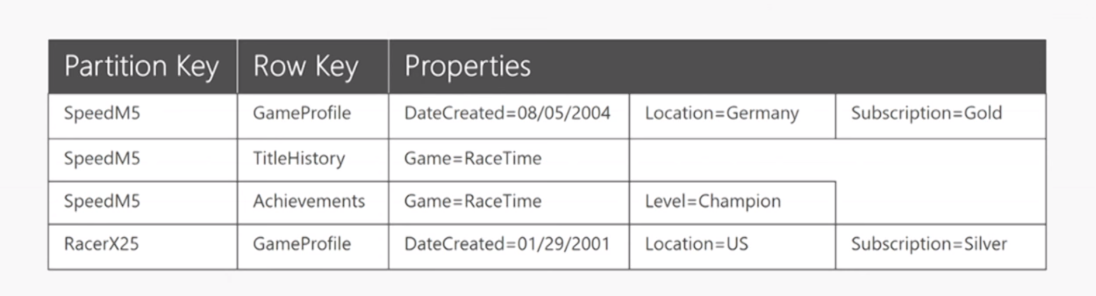
How is it stored?

Slide 11
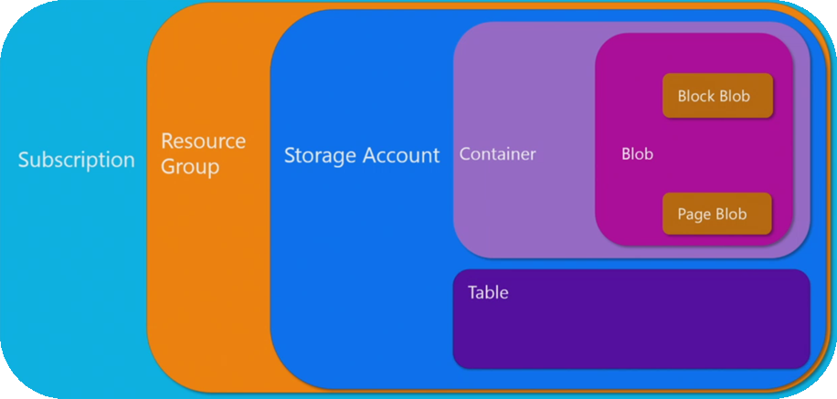
Relating Azure Storage concepts

Slide 12

Technical details
Number of storage accounts per region: 200
Max storage account capacity: 500 TiB
Max number of blob containers, blobs, file shares, tables, queues, entities, or messages per storage account: no limit
Maximum request rate per storage account: 20 000 request per second
All of these could be increased via contacting Microsoft’s support
Azure Storage Scalability and Performance Targets

Slide 13

Azure SQL database
Database as a Service (DaaS)
Simple SQL database hosted on the SQL server based in the cloud
Has additional cloud features for scaling and migrations
Azure SQL database documentation

Slide 14
Azure SQL database Demo

Slide 15

Azure Cosmos DB
Schema-free database system(service)
Multi-API support:
SQL
MongoDB
Graph
Table
Cassandra
Horizontal scaling
Multi-homing
Azure Cosmos DB documentation
Typical questions
Query playground
Why you need (and don’t need) a NoSQL database

Slide 16
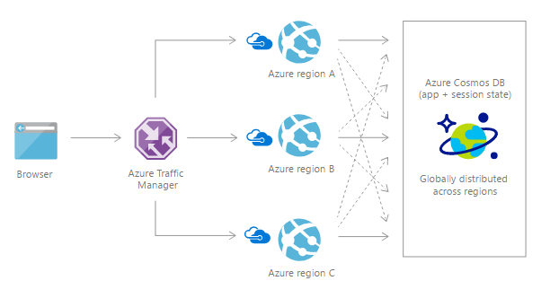
Multi-homing

Slide 17
Azure Cosmos DB Demo

Slide 18

Q&A
Credentials:
Dmitrii Gvozdev
Email: Dmitrii_Gvozdev@epam.com
Telegram: @GvozdevDA

